Slide 1
Making the Case for Languages in 2017
Dr. Bill Rivers
Executive Director, Joint National Committee for Languages
February 4, 2017

Slide 2
Growing our Enrollments
2013-14 Data: 30% increase in K-12 enrollments since 2007
K-12 survey funded by DLNSEO
Done by: American Councils with ACTFL, NCSSFL, MLA, CAL
K-12 enrolments:
10.9m of 54.1m students
21% of HS students in 2013-2014
16% of HS students in 2007
31% INCREASE
Higher education
MLA self-funded survey in 2012-2013
2013: 1.52m enrollments in higher education
2009: 1.61m enrollments in higher education
Higher education enrollments have declined by from 8.7% to 8.1 % of overall enrollments in higher education, a 6.9%
Questions: Growth in immersions? Proficiency outcomes? Articulation?

Slide 3
Washington: Looking Forwards
New Administration: JNCL-NCLIS has made contact with the Trump Administration and we are making the case:
Education
DoD
IC
Commerce/Labor
A new administration:
4,100 appointees
Who need to be educated:
Why language matters
Our programs
Opportunity!
We have the right message, the right data, the right results!

Slide 4
American Academy of Arts and Sciences & Language
AAAS – founded in 1780 by John Adams and others
Oldest US Academy, 2nd oldest in the world after the Royal Academy
2013: The Heart of the Matter – Commission on the Humanities and Social Sciences;
Requested by Congress in 2012
2013 – participant in the Languages for All summit
2014 –request from Congress to AAAS to assess the impact of language on the national interest
First broad based, Congressionally requested study since 1979 (Perkins Commission)
July 2015 – Commission established
New commission will work through 2016 to assess the impact of FL on education, global security, economic growth, and social justice
Then spend a second year proselytizing
JNCL-NCLIS, ACTFL, CAL, American Councils, CASL, and others have been working on this project for 2 years

Slide 5
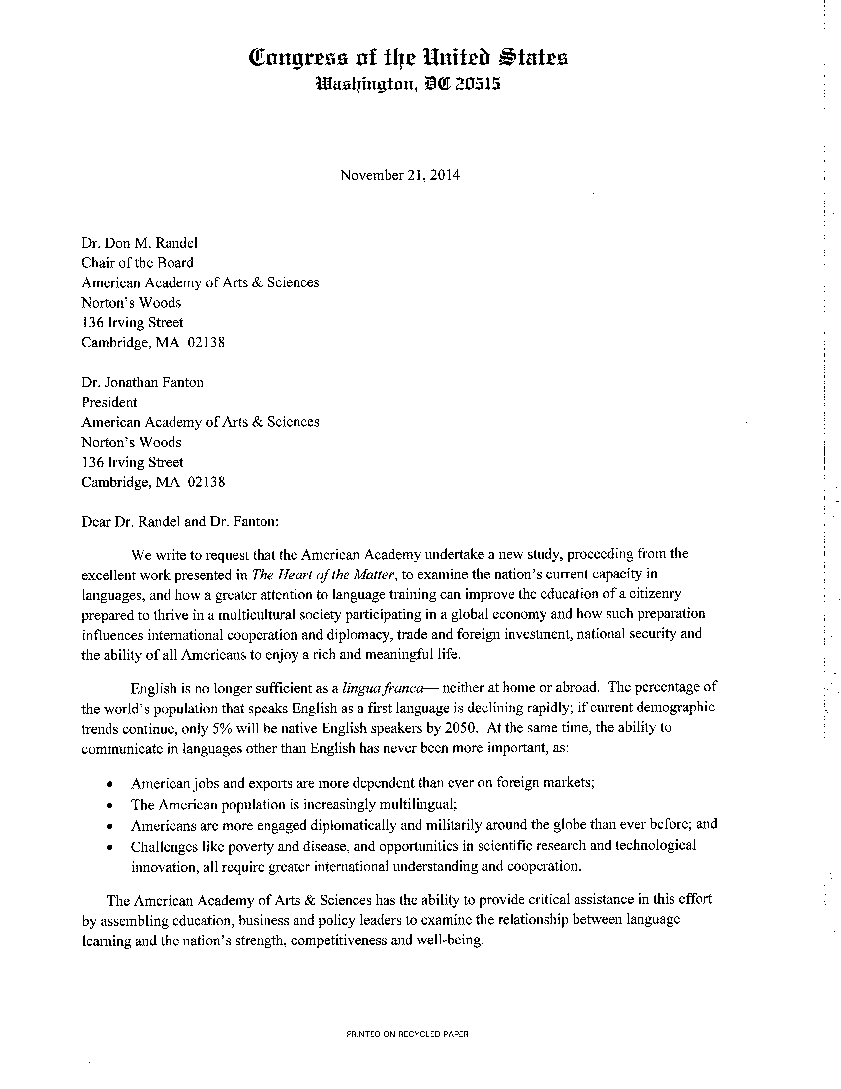

Slide 6
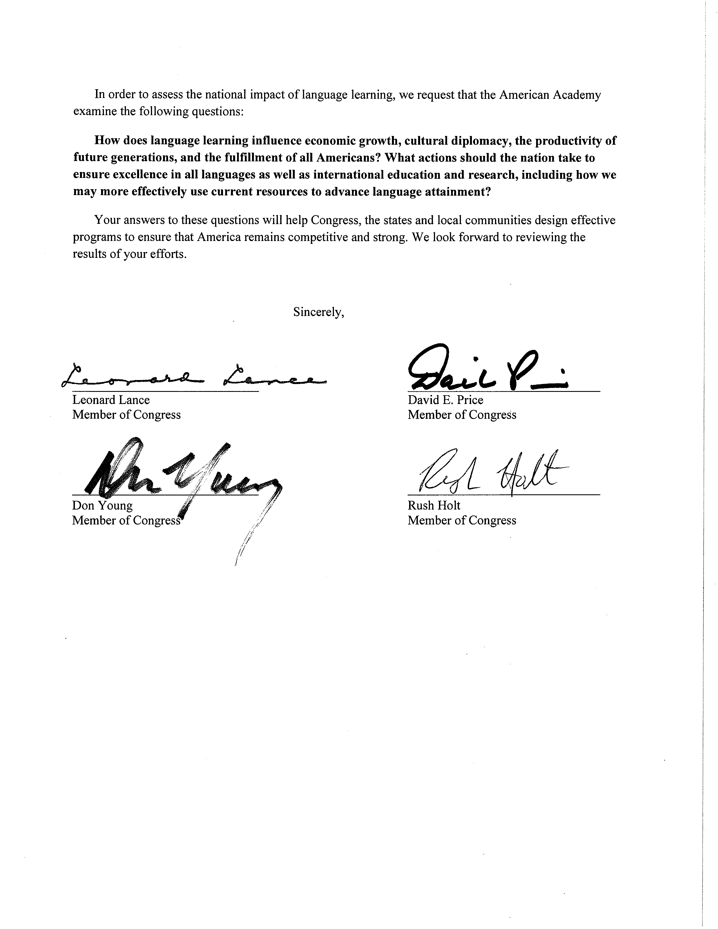

Slide 7
Commission members
Chair: Dr. Paul LeClerc, former CEO, NYPL and former president, CUNY-Hunter
Members as of 11/15/16 (* denotes a fellow of AAAS):
Dr. Dan Davidson, President, American Councils for International Education
Ms. Marty Abbott, Executive Director, ACTFL
Dr. Rosemary Feal, Executive Director, MLA
Dr. Brian Edwards,* Northwestern University
Amb. Karl Eikenberry*, LTG, USA (ret.), Stanford University
Dr. Pauline Yu*, President, American Council of Learned Societies
Dr. Nicholas Dirks*, Chancellor, University of California (Berkeley)
Ms. Jessie Little Doe Baird, Wôpanâak Nation
Dr. Mark Aronoff*, SUNY-Stonybrook Dept. of Linguistics
Dr. Phil Rubin, Haskins Lab
Dr. Ruben Rumbaut, University of California, Irvine
Hon. Diane Wood*, Chief Judge, US Court of Appeals, 7th Circuit
Dr. Carol Gluck*, Columbia University
Ken Wallach, Executive Chairman, Central National Gottesman
Dr. Hunter Rawlings*, American Association of Universities
Dr. David S. C. Chu, President, instituted for Defense Atlases
Amb. Nancy McEldowney, Foreign Service Institute
Dr. Marta Tienda*, Princeton University

Slide 8
Next steps for the Commission
Presentation of the Report: February 28, Washington, DC
Data report: State of Languages in the US
Briefing papers:
America’s Languages: Challenges and Promise: American Councils Research Center
The Contribution of Language to the Economic Interests of the US: JNCL
Language and Global Security: McGinn Associates
Language, Education, and Cognition: Penn State University, Center for Language Science
Language Preservation and Language Access: Center for Applied Linguistics
2017-2018: evangelizing
https://www.amacad.org/content/Research/researchproject.aspx?i=21896

Slide 9
The Case for Languages: The Commission’s white papers
Briefing papers requested by the Commission; aligned with the questions asked by the Congress
Available on website
Cover all the bases for language advocacy!
America’s Languages: Challenges and Promise: American Councils Research Center (Richard D. Brecht, lead author)
The Contribution of Language to the Economic Interests of the US: JNCL (Bill Rivers, lead author)
Foreign Language, Cultural Diplomacy, and Global Security: McGinn Associates (Gail McGinn, lead author)
Language and Productivity for All Americans: Penn State University, Center for Language Science (Judy Kroll, lead author)
Language Preservation and Language Access: Center for Applied Linguistics (Terry Wiley, lead author)

Slide 10
Briefing Paper: America’s Languages: Challenges and Promise
Overview paper for the Commission
Premise: There are a great many reasons to invest in language learning
Educational & Cognitive benefits from bilingualism
Global security
Economic growth
There are significant challenges:
Perceptions among policy makers at all levels that English is enough, that the rest of the world is learning English, that other subjects (e.g., coding) are more important
Perceptions among policy makers that language learning is too hard – can’t be done
But there’s reason for optimism:
Outcomes: where we do language well (e.g., DLIFLC, Dual Language, Flagships) – we do it very well indeed – at the Advanced threshold for HS graduates and Superior and beyond for college graduates
Public support – parents want languages for their kids
The employment sector wants “linguistic and cultural human capital”

Slide 11
Briefing Paper: The Contribution of Language to the Economic Interests of the US
Language is an important component of the US economy
The language industry has annual revenues in the US of at least $15b
The language industry provides work for more than 200,000 Americans, at an annual pay averaging $80,000
The public sector – teaching at all levels, US Government linguists – employs at least another 150,000 Americans
The Language industry is highly tech-savvy
Translation, localization, and globalization depend on technology
Language learning makes increasing, innovative use of technology
The broader employment sector increasingly values “global talent”
11% of US mid- and large-size companies (of which there are 120,000) seek to fill jobs requiring language (Michigan State University Recruiting Trends Survey)
45% of US companies give advantage to candidates with language skills
Language and cultural expertise are equated with flexibility, adaptability, prudent risk-taking, and interpersonal skills
Global Talent = Language + another skill [teaching, translating, accounting, engineering, etc.)

Slide 12
Briefing Paper: Foreign Language, Cultural Diplomacy, and Global Security
Language is vital to how the US meets its global responsibilities
The Federal Government faces persistent challenges in building and sustaining the required language capacity
Diversity of languages required for Federal Agencies
Diversity of agencies & missions
Diversity of languages
Historically, responding only to imminent crises (World War II, Sputnik/Cold War, Iranian Revolution, Gulf War)
After 9/11, sustained efforts across the US Government:
National Security Language Initiative
Defense Language Transformation Roadmap
National Language Service Corps
The Language Flagship
StarTALK

Slide 13
Briefing Paper: Language and Productivity for All Americans
Bilingualism confers many cognitive and educational benefits
No matter how or when acquired
Language use is the key factor – the more the better, higher proficiency correlates with larger effects
Biliteracy matters, especially for educational effects
Educational:
Children in dual language programs perform better on standardized tests by 5th grade (North Carolina, Portland, SF studies)
Bilinguals acquire additional languages much faster – 2x as fast if the languages are related (e.g., French and Spanish); but this holds even for unrelated languages
Cognitive
Infants in bilingual households process information more efficiently
Bilingual children have better executive control (attention, planning)
Bilingualism in adults correlates with a 5-year delay in the onset of the symptoms of Alzheimer’s disease
Bilingualism in adults slows other cognitive decay later in life (memory, task switching, attention)

Slide 14
Briefing Paper: Language and the Fulfillment of the Potential of all Americans
60 million Americans speak a language other than English at home
We don’t have enough programs for heritage language speakers to maintain their home languages
English Language Learner programs, required by Federal law as a matter of civil rights, are also insufficient for the demand
Dual Language has emerged in the past ten years as the most effective ELL program
But teacher shortages and funding shortages limit the capacity
Civil Rights regulations ensure access to social services for those who can’t speak English
Capacity has not grown as fast as the demand, especially in languages of lesser diffusion
Discrimination persists, especially in the workplace

Slide 15
Contact
Bill Rivers, wrivers@languagepolicy.org

